Slide 1
Probabilistic Robotics: Historgam Localization
Sebastian Thrun & Alex Teichman
Stanford Artificial Intelligence Lab
Slide credits: Wolfram Burgard, Dieter Fox, Cyrill Stachniss, Giorgio Grisetti, Maren Bennewitz, Christian Plagemann, Dirk Haehnel, Mike Montemerlo, Nick Roy, Kai Arras, Patrick Pfaff and others
_x0016__x001a__x001a__x001a__x001a_

Slide 2
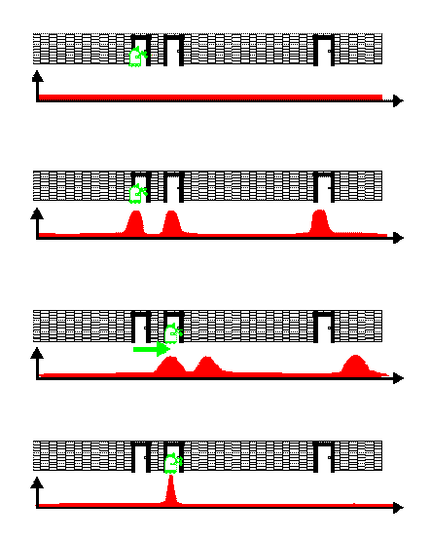
Bayes Filters in Localization

Slide 3
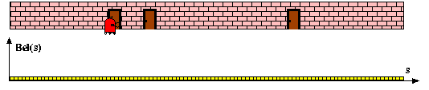
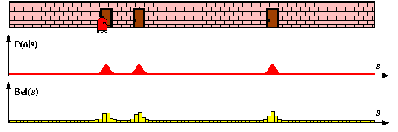
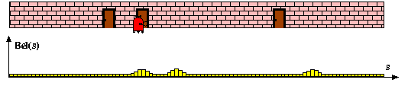
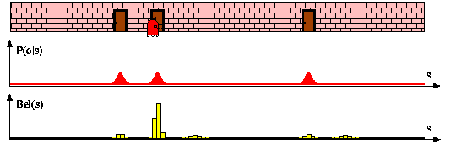
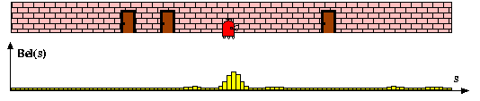
Histogram =
Piecewise
Constant

Slide 4
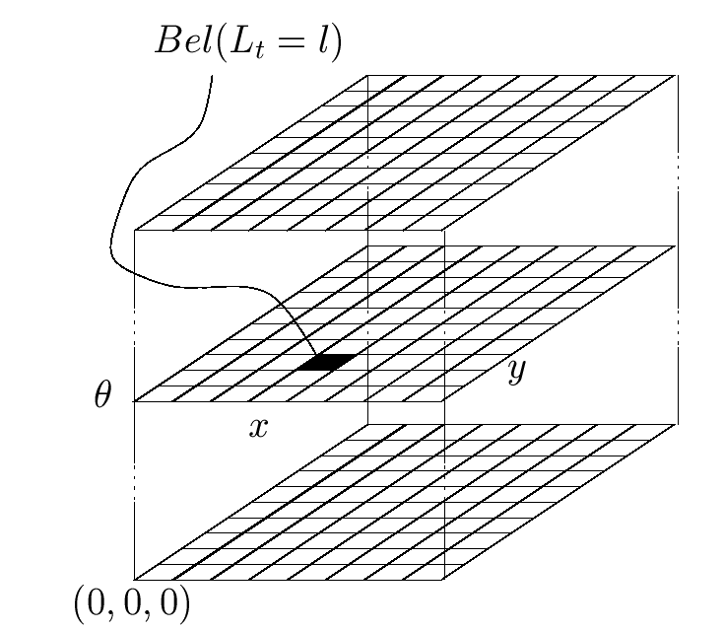

Piecewise Constant Representation

Slide 5



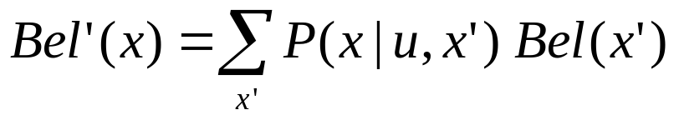
Discrete Bayes Filter Algorithm
Algorithm Discrete_Bayes_filter( Bel(x),d ):
η=0
If d is a perceptual data item z then
For all x do
For all x do
Else if d is an action data item u then
For all x do
Return Bel’(x)

Slide 6
Implementation (1)
To update the belief upon sensory input and to carry out the normalization one has to iterate over all cells of the grid.
Especially when the belief is peaked (which is generally the case during position tracking), one wants to avoid updating irrelevant aspects of the state space.
One approach is not to update entire sub-spaces of the state space.
This, however, requires to monitor whether the robot is de-localized or not.
To achieve this, one can consider the likelihood of the observations given the active components of the state space.

Slide 7
Implementation (2)
To efficiently update the belief upon robot motions, one typically assumes a bounded Gaussian model for the motion uncertainty.
This reduces the update cost from O(n²) to O(n), where n is the number of states.
The update can also be realized by shifting the data in the grid according to the measured motion.
In a second step, the grid is then convolved using a separable Gaussian Kernel.
Two-dimensional example:
1/16
1/8
1/16
1/4
≅
+
1/8
1/4
1/8
1/2
1/4
1/2
1/4
1/16
1/8
1/16
1/4
  Fewer arithmetic operations
  Easier to implement

Slide 8
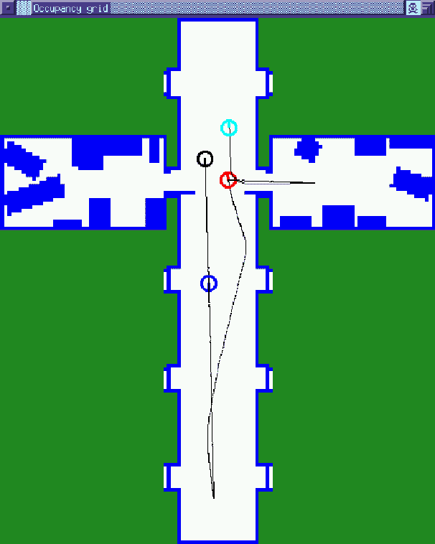
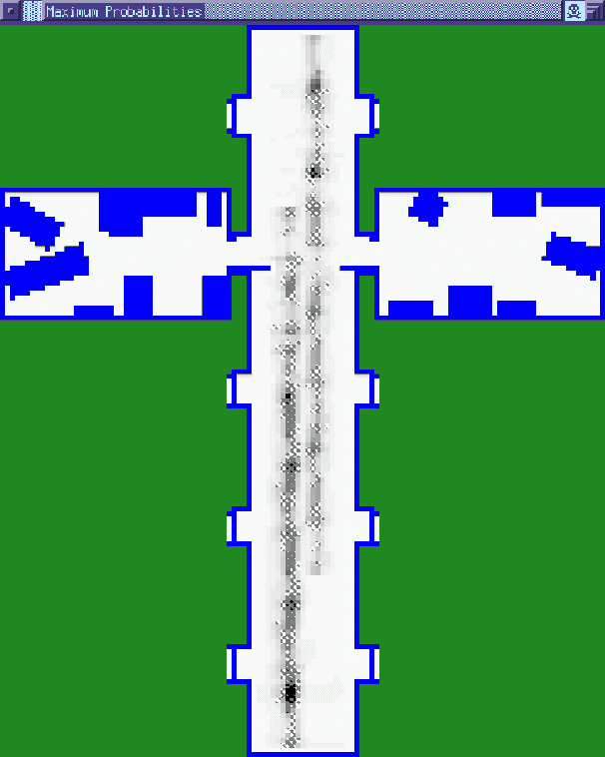
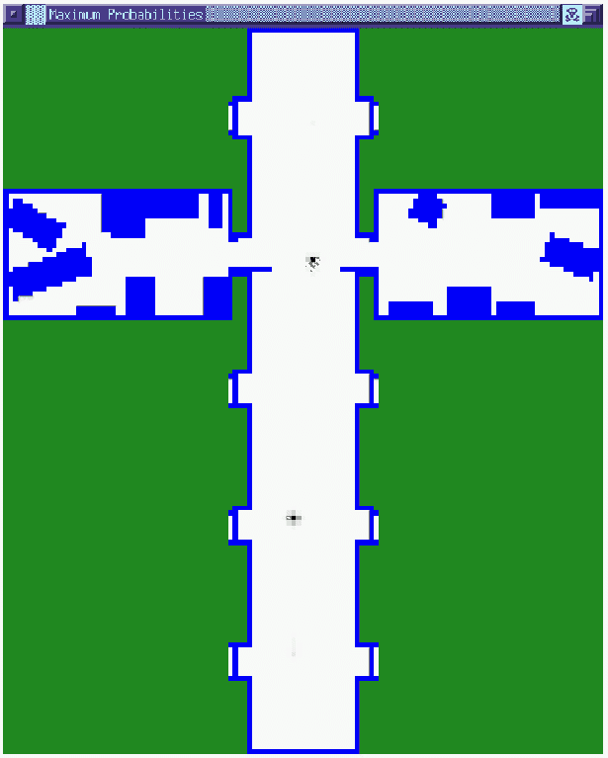

Markov Localization in Grid Map

Slide 9
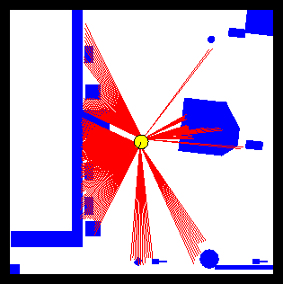
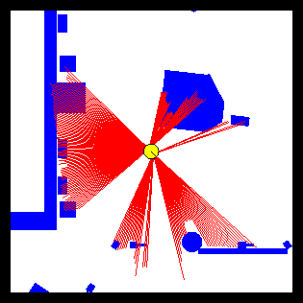
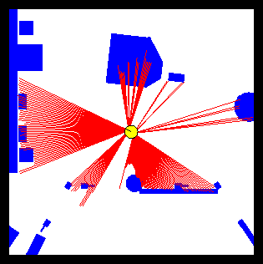
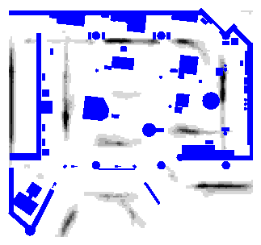
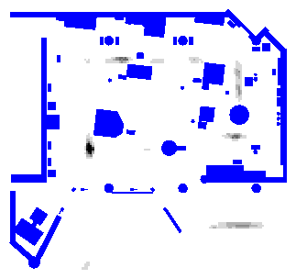
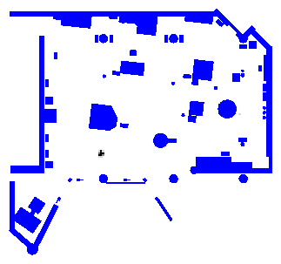
Grid-based Localization

Slide 10
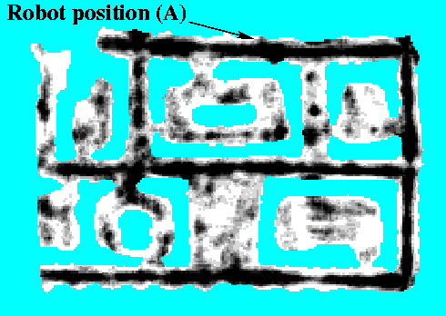
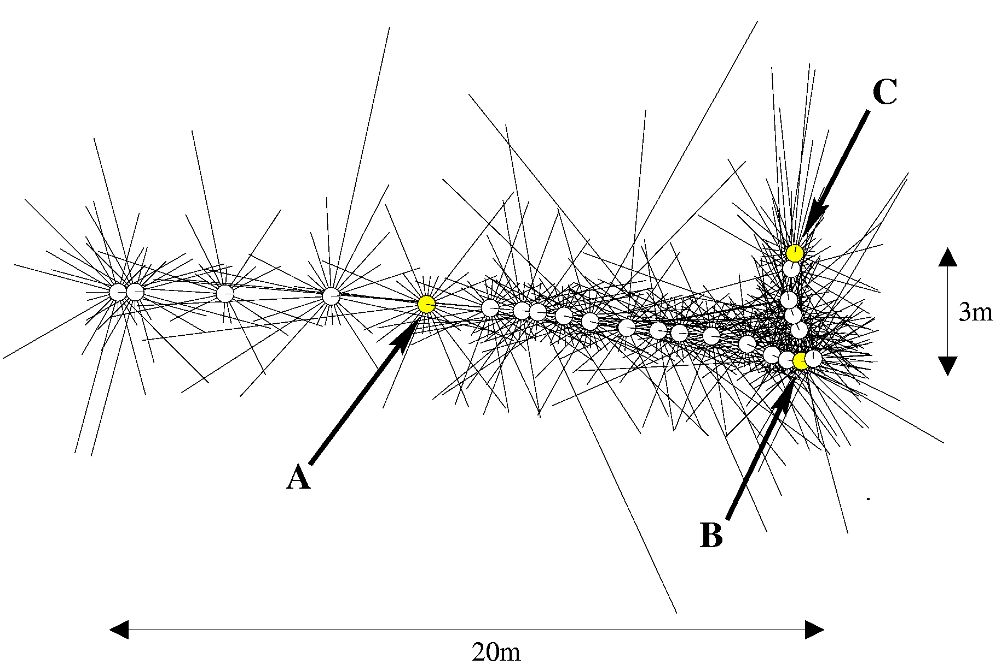
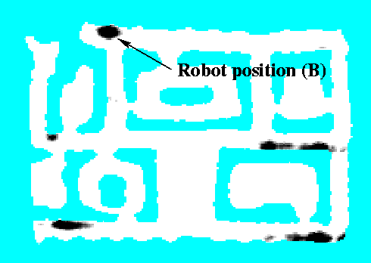

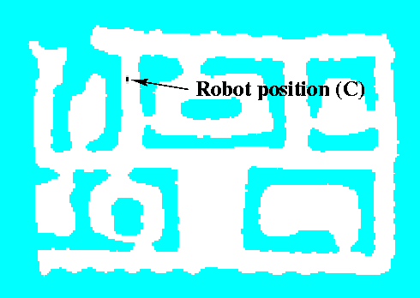
Sonars and
Occupancy Grid Map

Slide 11
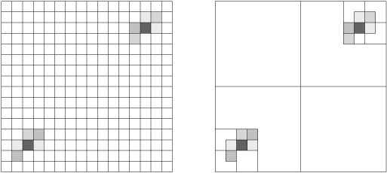
Tree-based Representation
Idea: Represent density using a variant of octrees

Slide 12
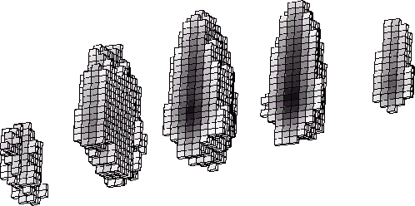
Tree-based Representations
Efficient in space and time
Multi-resolution

Slide 13
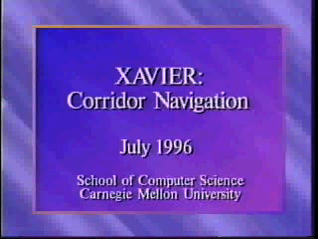
Xavier:
Localization in a Topological Map

Slide 14
Summary:
Discrete Markov Localization
Most basic probabilistic localization algortihm
Handles global uncertainty (e.g., global localization)
Handles local uncertainty (e.g., tracking)
Scales exponentially with number of dimensions; requires further algorithmic work for efficiency

